Slide 1
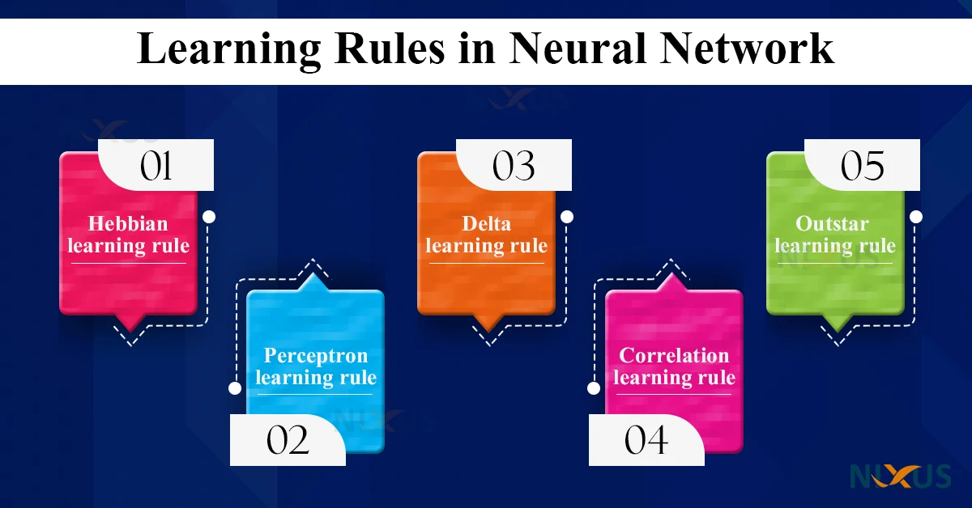
Learning Rules (theory) in Neural Network
Dr. Rahman Ali
University of Peshawar
Dr. Rahman Ali University of Peshawar

Slide 2
Learning Rules in Neural Network
Learning Rule
The learning rule is a technique or a mathematical logic learning rule is a method that helps a neural network learn and improve its performance
How it Works?
The learning rule changes the weights and biases of the network based on the data it sees, so the network can make better decisions over time.
Types of ANN Learning Rules
Hebbian learning rule –
Perceptron learning rule –
Delta learning rule –
Correlation learning rule –
Outstar learning rule –

Slide 3
Learning Rules in Neural Network
Types
Strengthen weights based on how strongly input correlates with output.
Δw = η × X × d
variant of the Hebbian rule; actual output is replaced by target (desired) output in the weight update calculation.
Learning rule or Learning process is a method or a mathematical logic. It improves the Artificial Neural Network’s performance and applies this rule over the network.
Thus learning rules updates the weights and bias levels of a network when a network simulates in a specific data environment.
Applying learning rule is an iterative process. It helps a neural network to learn from the existing conditions and improve its performance.
Hebbian learning rule – It identifies, how to modify the weights of nodes of a network.
Perceptron learning rule – Network starts its learning by assigning a random value to each weight.
Delta learning rule – Modification in sympatric weight of a node is equal to the multiplication of error and the input.
Correlation learning rule – The correlation rule is the supervised learning.
Outstar learning rule – We can use it when it assumes that nodes or neurons in a network arranged in a layer.
Update weights only when the perceptron misclassifies a pattern.
Δw= η × (Y’−Y) × X
Works for binary classification and linearly separable data.
"Neurons that fire together, wire together.“
Δw = η × X × Y
X = input
Y = output (activation of neuron)
η = learning rate
Minimize the mean squared error using gradient descent.
Δw= η × (Y’−Y) × X
(Same as perceptron, but applied to analog/continuous output & differentiable activation.)
A single source neuron trains multiple output neurons; each weight tries to match the desired output value.
Δw = η × (d−w) × a_{s}
Where:
d = desired output
w = current weight
a_{s} = activation of source neuron

Slide 4
Habbian Learning
History
The Hebbian rule was the first learning rule.
In 1949 Donald Hebb developed it as learning algorithm of the unsupervised neural network.

Slide 5
Hebb (1949) Neurophysiological Postulate
If neuron A keeps activating neuron B again and again, some change happens in the cells, and A becomes better and stronger at activating B in the future.

Slide 6
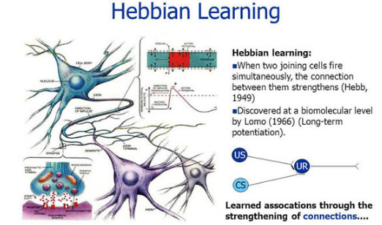
Habbian Learning
“Neurons that fire together, wire together.”
When two neurons activate at the same time again and again, their connection becomes stronger. This stronger connection helps the brain learn, remember things, and build skills by repeating them.

Slide 7
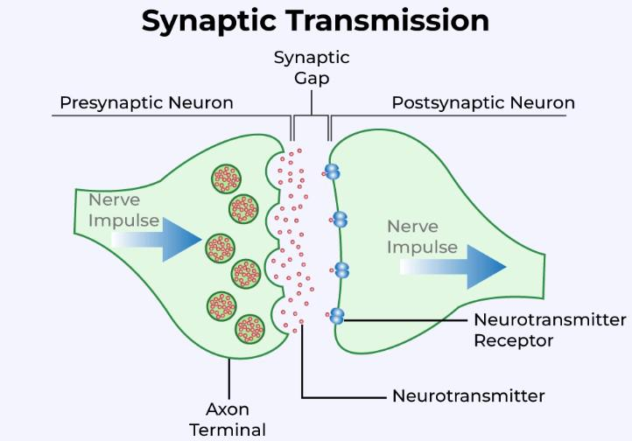
Difference Between Presynaptic Neuron and Postsynaptic Neuron
The presynaptic neuron sends the signal.
The postsynaptic neuron receives the signal.
The presynaptic neuron releases chemicals (neurotransmitters) that cross the gap and activate the postsynaptic neuron.

Slide 8
Habbian Learning
Hebbian Assumption :
If two nearby neurons turn on and off together, their connection (weight) becomes stronger.
If they work opposite to each other, the connection becomes weaker.
If their signals are not related, the connection does not change.

Slide 9
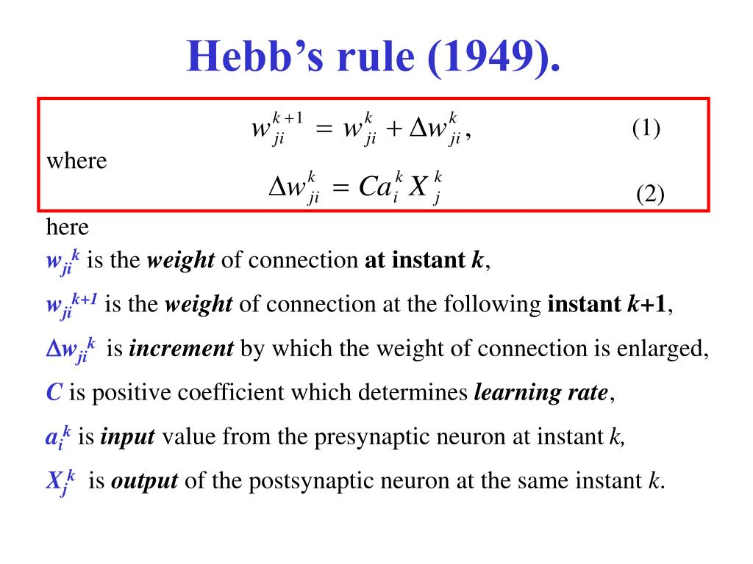
Equation (2) emphasises the correlation nature of a Hebbian synapse. It is referred to as the activity product rule.

Slide 10
Flaw in Hebb’s Law
Original Hebb’s Rule:
“Neurons that fire together, wire together.”
Flaw:
It only increases the connection strength (weight).
If used repeatedly, the weight keeps growing without any limit.
This unlimited growth is unrealistic and causes instability.

Slide 11
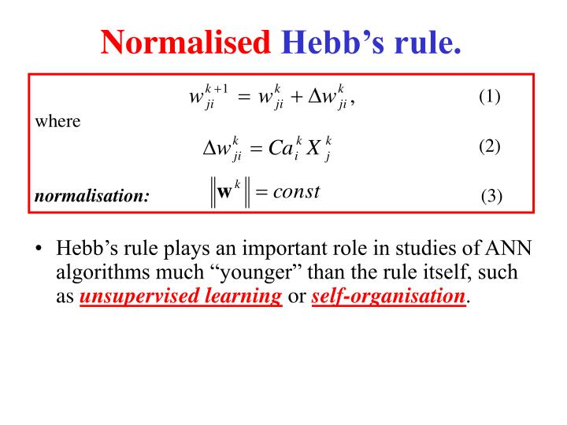
The Normalization Rule (The Fix)
Synaptic Normalization (Simple):
It is an improvement added to Hebbian learning.
It keeps the total strength of a neuron’s connections limited and balanced.
Analogy:
Like having a fixed budget:
If one connection gets stronger,
other connections must weaken a little
so the total strength stays the same.

Slide 12
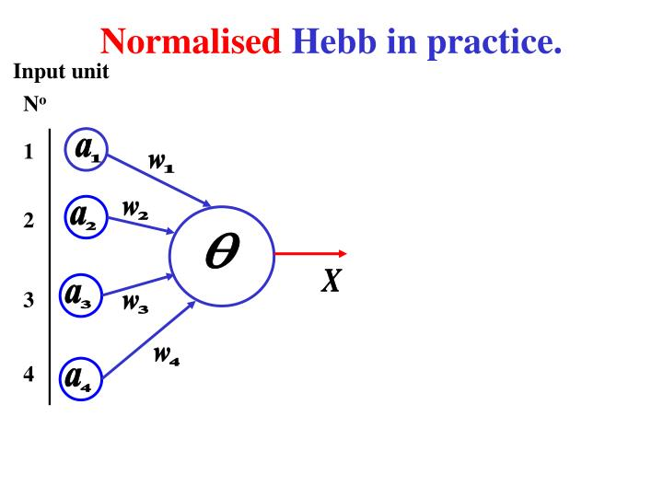
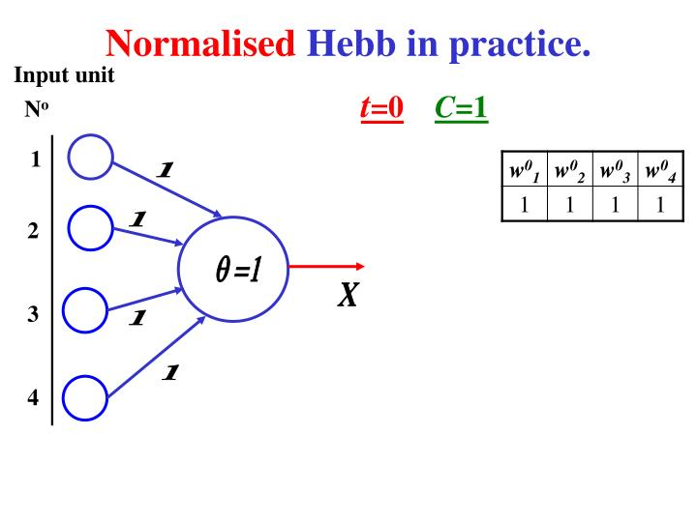

Slide 13
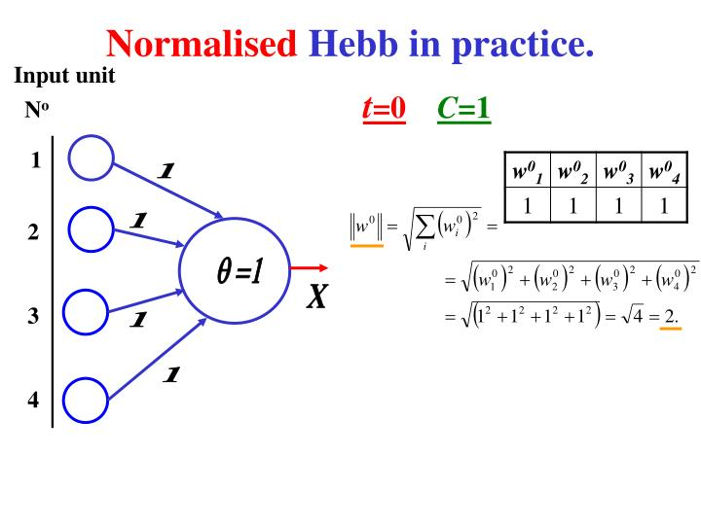

Euclidean Norm, derived from the Pythagorean theorem applied to N-dimensional space.

Slide 14
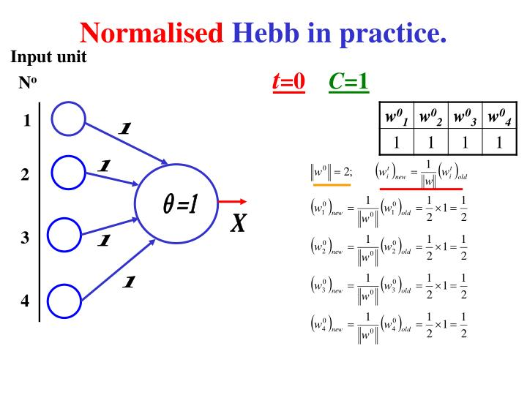
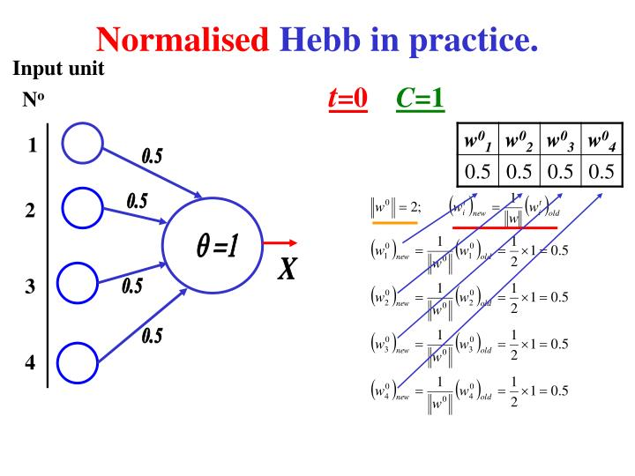

Slide 15
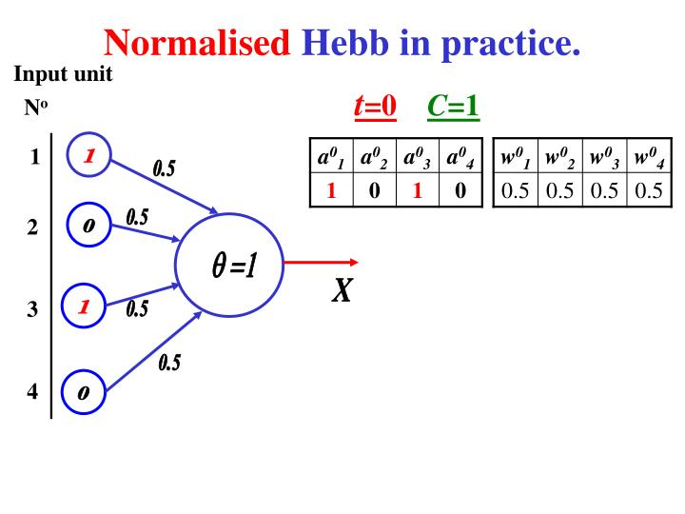
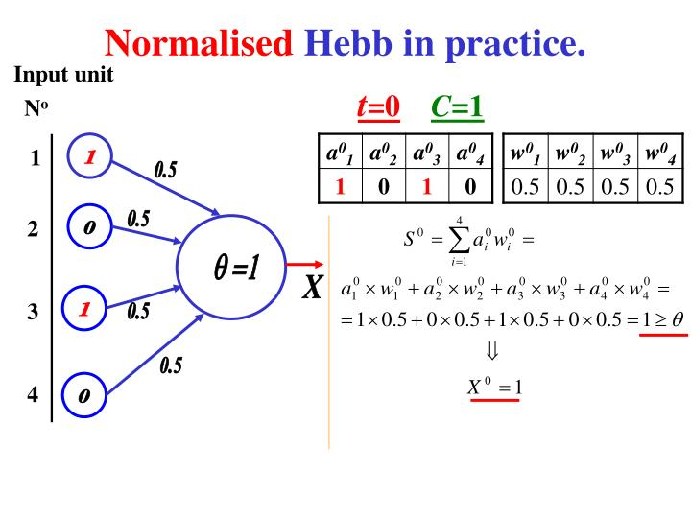

Slide 16
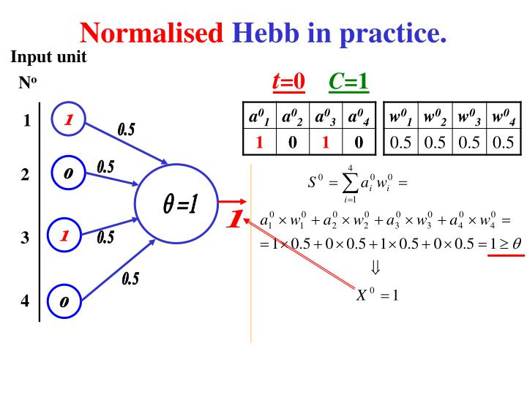
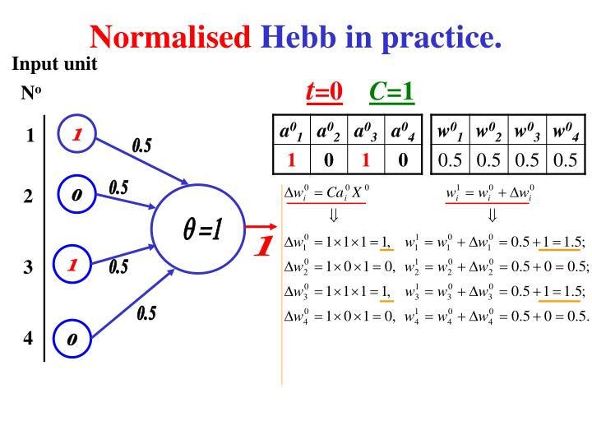

Slide 17
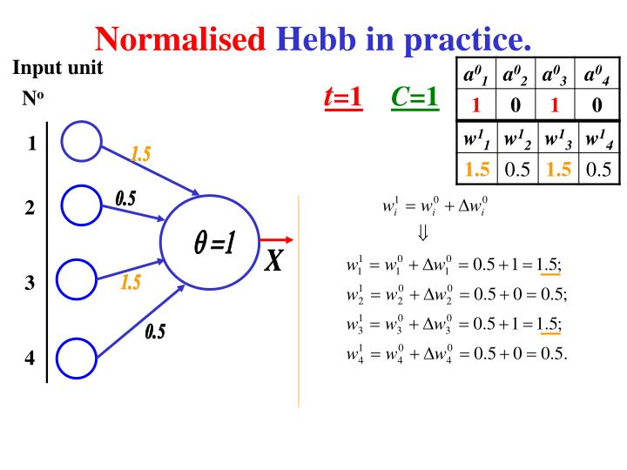
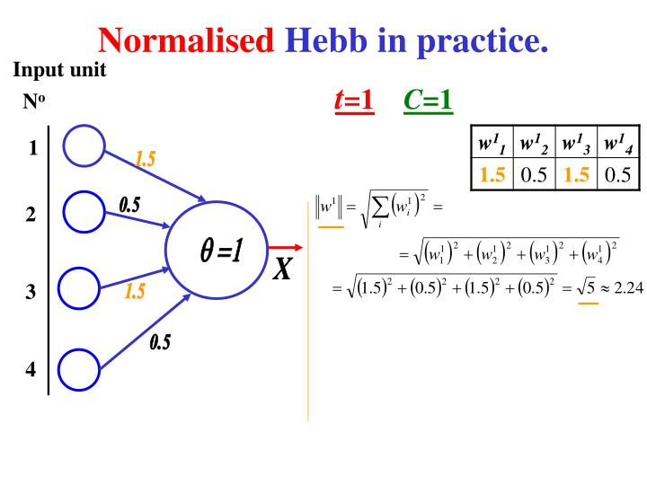

Slide 18
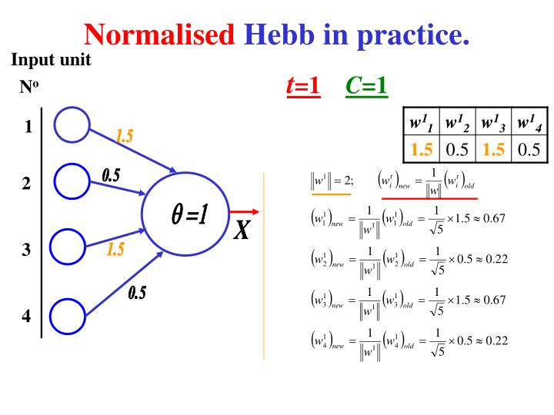
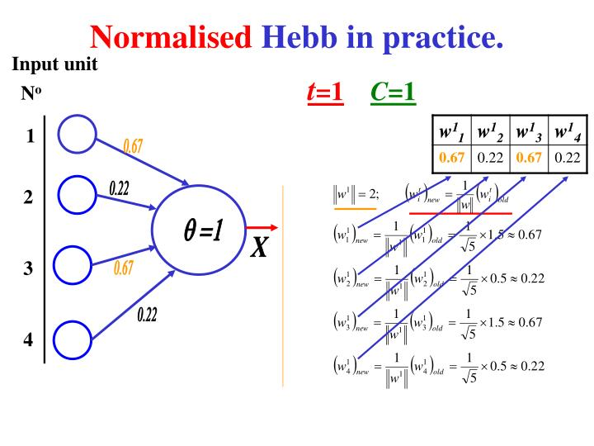

Slide 19
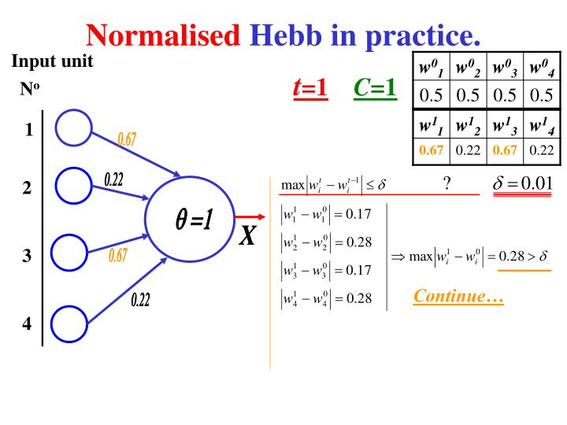
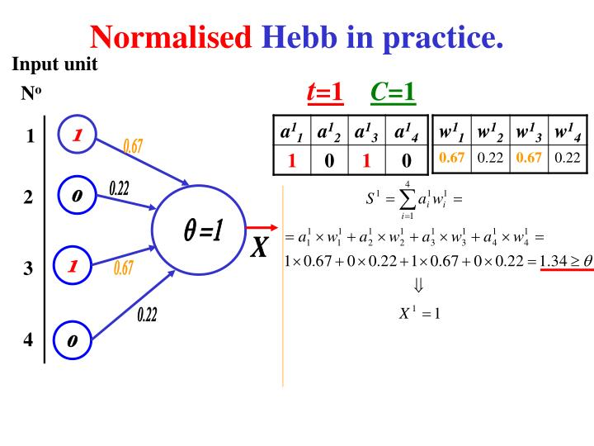

Slide 20
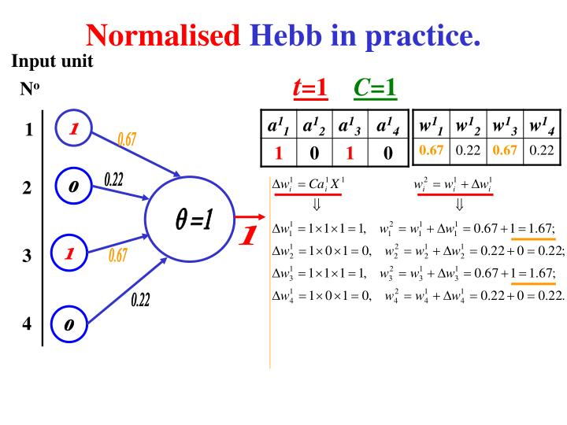

Slide 21
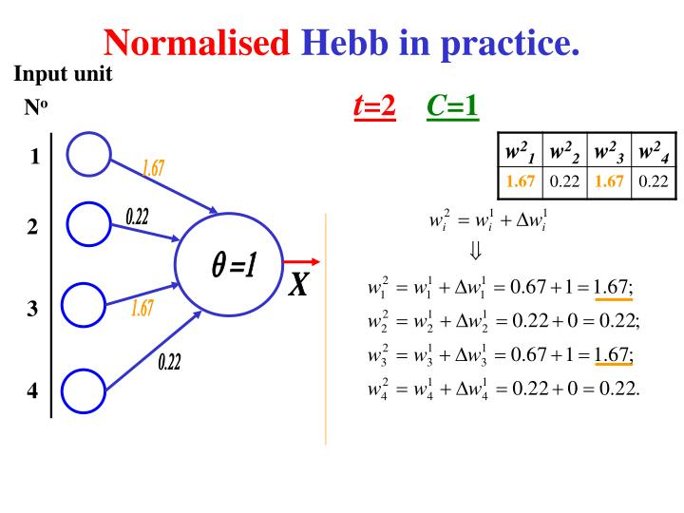
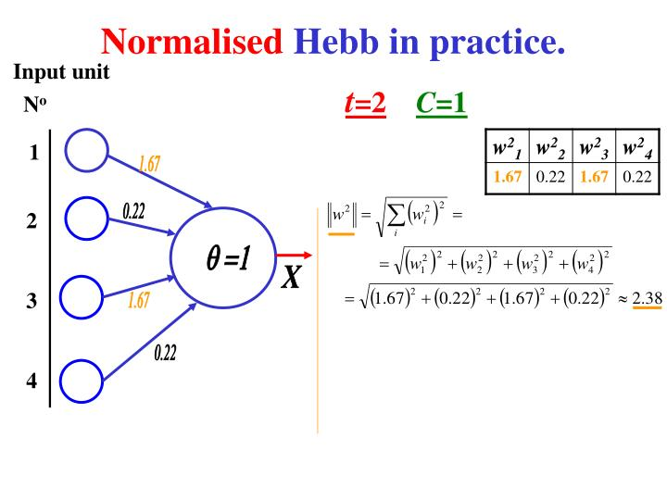

Slide 22
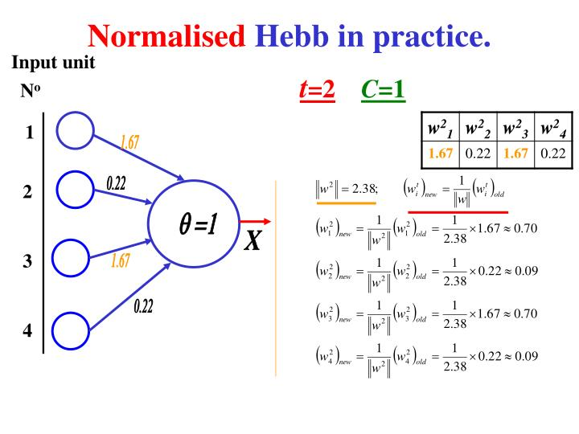
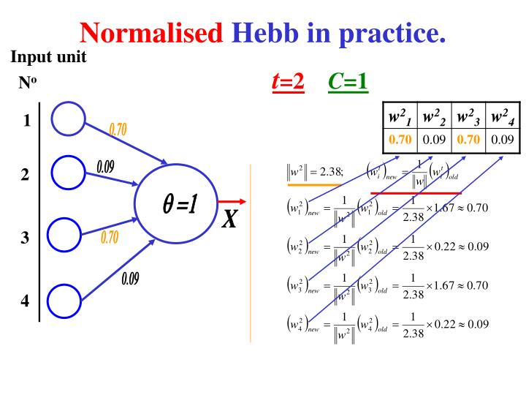

Slide 23
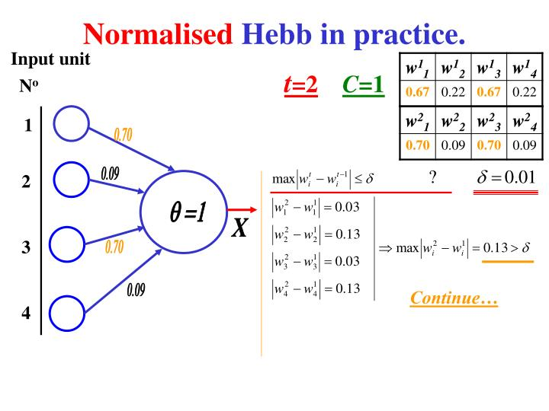
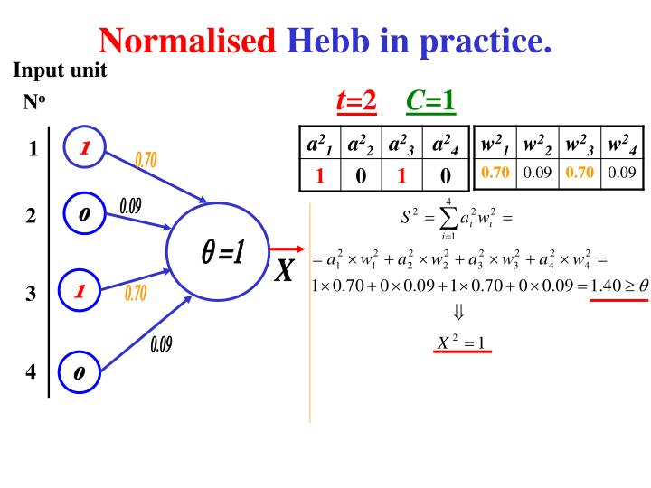

Slide 24
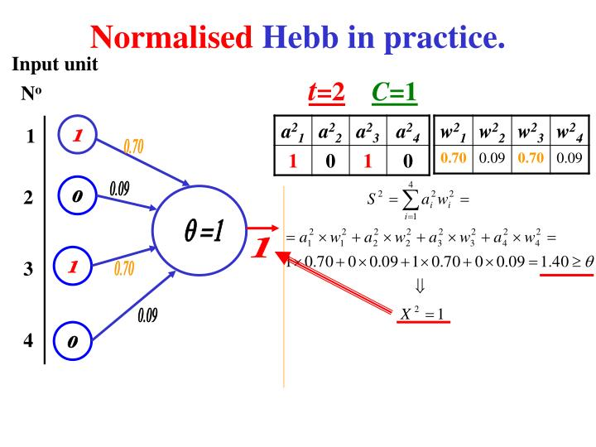


Slide 25
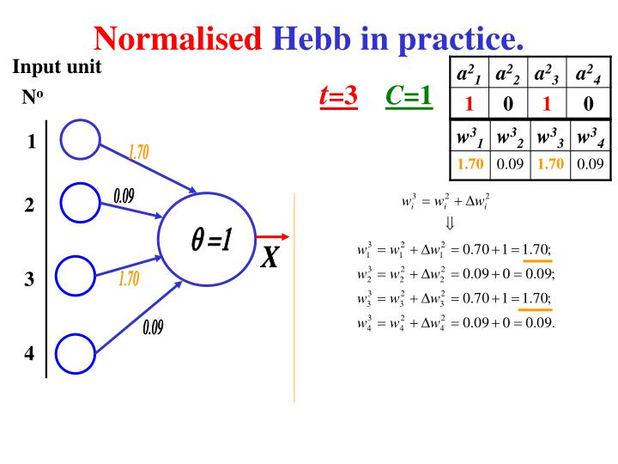
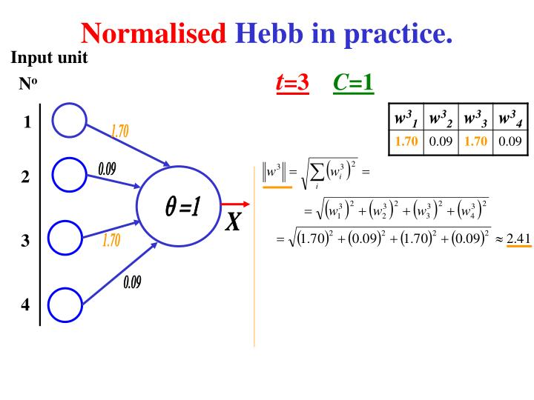

Slide 26
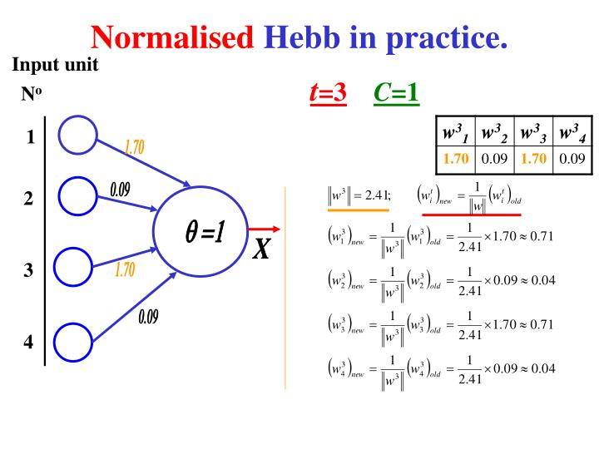
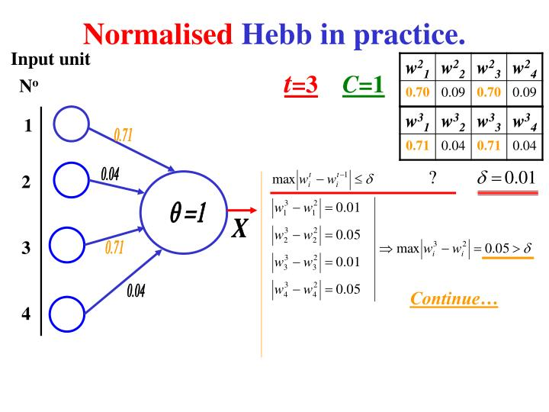

Slide 27



Slide 28
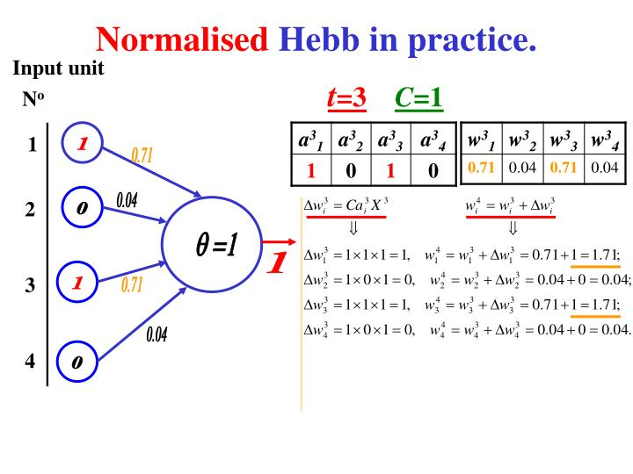
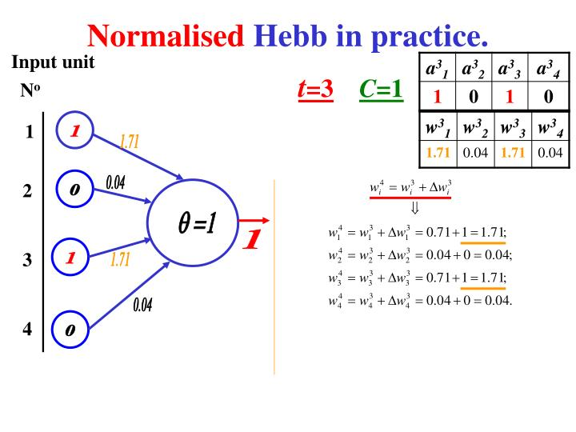

Slide 29

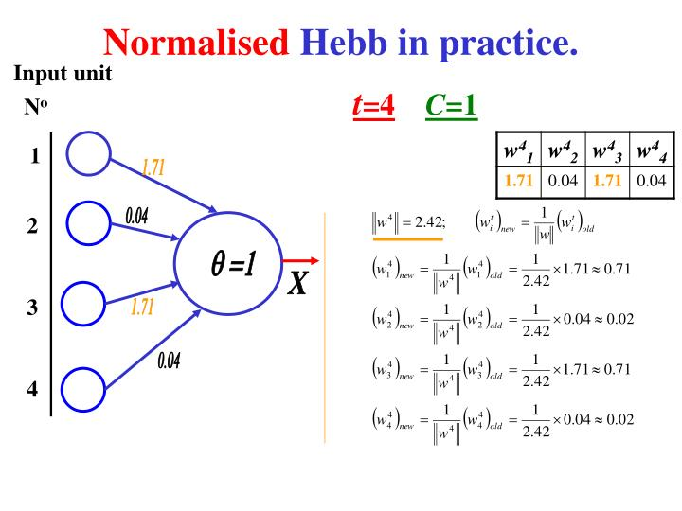

Slide 30
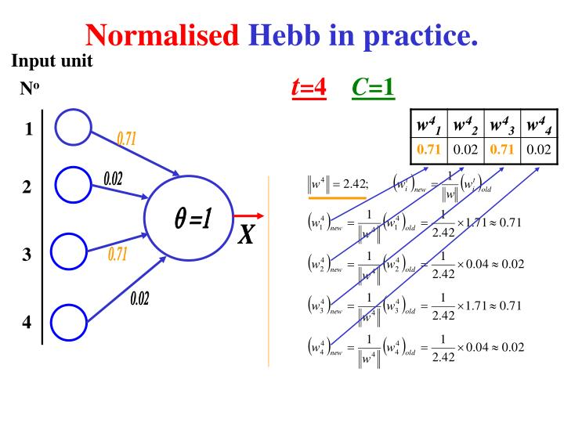
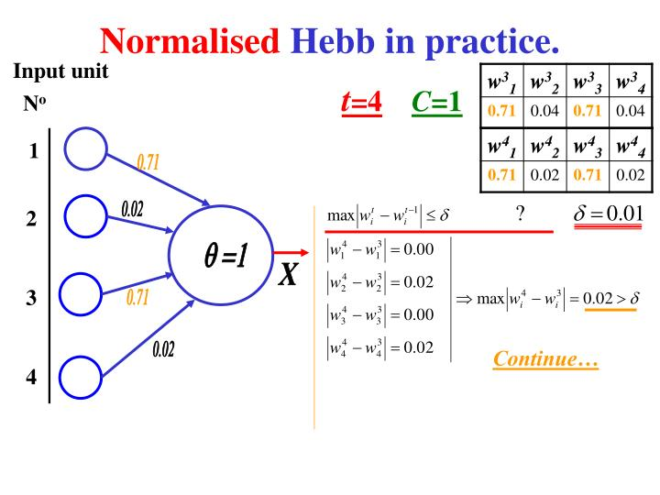

Slide 31



Slide 32



Slide 33



Slide 34

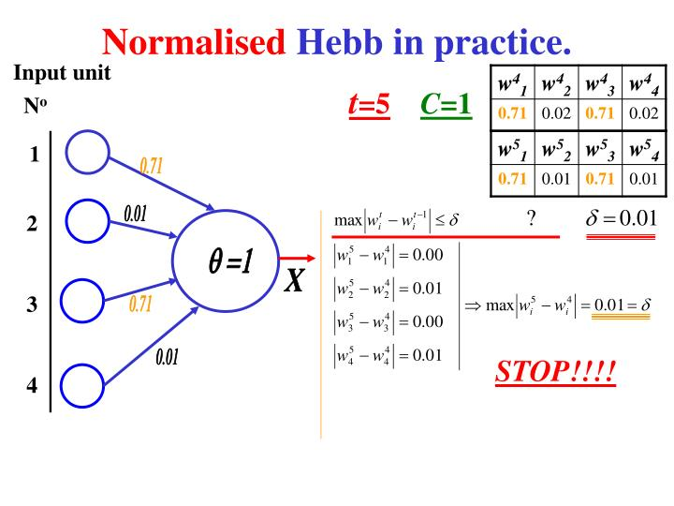

Slide 35
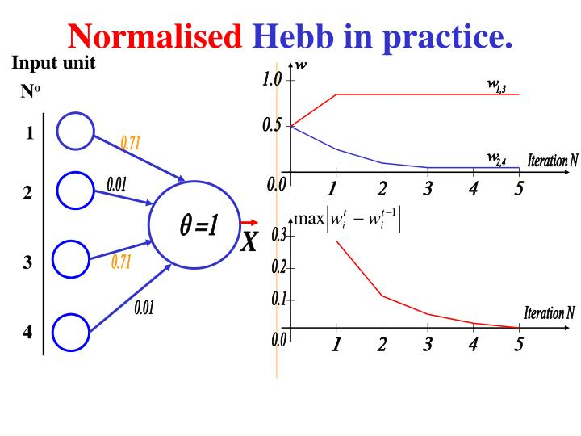

Slide 36
